Slide 1
Views & Indexes in SQL
Lab # 8

Slide 2
VIEWS
The view is a virtual table. It does not physically exist. Rather, it is created by a query joining one or more tables.
A view contains rows and columns, just like a real table
The fields in a view are fields from one or more real tables in the database
Syntax:
CREATE VIEW view_name AS
SELECT column_name(s)
FROM table_name
WHERE condition;
Notes:
2

Slide 3
View Creation - Example
CREATE VIEW ProductView AS
SELECT ProductName, UnitPrice
FROM Products
WHERE UnitPrice > (SELECT AVG(UnitPrice) FROM Products);
This View (Create statement) would create a virtual table based on the result set of the select statement. You can now query the view as follows
SELECT *
FROM ProductView;
Notes:
3

Slide 4
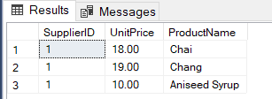
CREATE VIEW SupplierProduct AS
SELECT s.SupplierID, p.UnitPrice, p.ProductName
FROM suppliers AS s, Products AS p
WHERE s.SupplierID = p.SupplierID and s.CompanyName = 'Exotic Liquids';
SELECT *
FROM SupplierProduct;

Slide 5
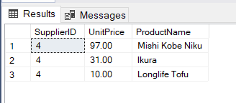
ALTER VIEW SupplierProduct AS
SELECT s.SupplierID, p.UnitPrice, p.ProductName
FROM suppliers AS s, Products AS p
WHERE s.SupplierID = p.SupplierID and s.CompanyName = 'Tokyo Traders’;
SELECT *
FROM SupplierProduct;

Slide 6
DROPPING VIEW
The syntax for dropping a VIEW :
View Drop - Example
DROP VIEW view_name;
DROP VIEW SupplierProduct;
Notes:
Question: Can you update the data in an view?
Answer : A view is created by joining one or more tables. When you update record(s) in a view, it updates the records in the underlying tables that make up the View.
So, yes, you can update the data in View providing you have the proper privileges to the underlying tables.
Question: Does the SQL View exist if the table is dropped from the database?
Answer: Yes, View continues to exist even after one of the tables (that the SQL View is based on) is dropped from the database. However, if you try to query the View after the table has been dropped, you will receive a message indicating that the View has errors.
6

Slide 7
INDEX
The CREATE INDEX statement is used to create indexes in tables
Indexes allow the database application to find data fast; without reading the whole table
An index can be created in a table to find data more quickly and efficiently
The users cannot see the indexes, they are just used to speed up searches/queries
Notes:
7

Slide 8
INDEX
CREATE INDEX
- Creates an index on a table.
- Duplicate values are allowed.
Syntax
CREATE INDEX index_name
ON table_name (column_name);
Notes:
8

Slide 9
INDEX
CREATE INDEX
- Creates an index on a table.
- Duplicate values are NOT allowed.
Syntax
CREATE UNIQUE INDEX index_name
ON table_name (column_name);
NOTES: UNIQUE indicates that the combination of values in the indexed columns must be unique
Notes:
9

Slide 10
INDEX
DROP an INDEX Syntax
- The Syntax for dropping an index is:
DROP INDEX TABLENAME.index_name;
Notes:
10

Slide 11
Clustered Vs Non - Clustered Index
Clustered Index:
This is similar to the telephone directory, where the name is arranged in a sorted order
we directly locate the name and then the phone number in front of it
When a primary key is created on a table, by default clustered index is created.
There can be only one clustered index per table.
The column on which index is created will be physically sorted
Non - Clustered Index:
This is similar to the index behind the text book, where we look for a key word in the index and find the page.
And then go to that page and again search manually for the key word.
We cannot locate directly like the phone number we got in case of clustered index.
When a unique key is created on the table, by default a non-clustered index is created.
There can be multiple non-clustered indexes created on a table.
The column on which index is created will be logically sorted.

Slide 12
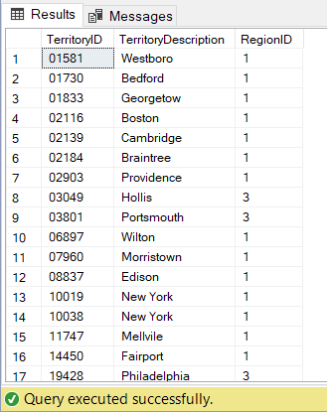
Example:
SELECT *
FROM Territories;
CREATE CLUSTERED INDEX abcd
ON Territories(TerritoryID);
SELECT *
FROM Territories;

Slide 13
LAB TASK
Add a view called Managers in the Northwind database that shows only employees that are not ‘Sales Representative’
Create Northwind view called “Products by Category” based on the columns CategoryName and ProductName.
Create a view that shows a table that list all the publishers and store names using pubs.
Create a view that shows a table that list all the authors and store names using pubs.
Create a view the amount total amount spend by customers.
Create a view for customers shippers information.
Add clustered index on region description in table region
Add index no on country in table Employee

